Slide 1


Slide 2
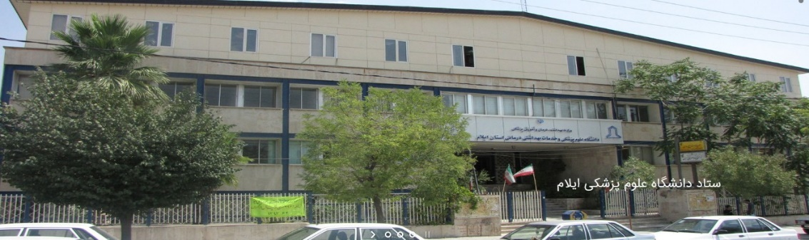
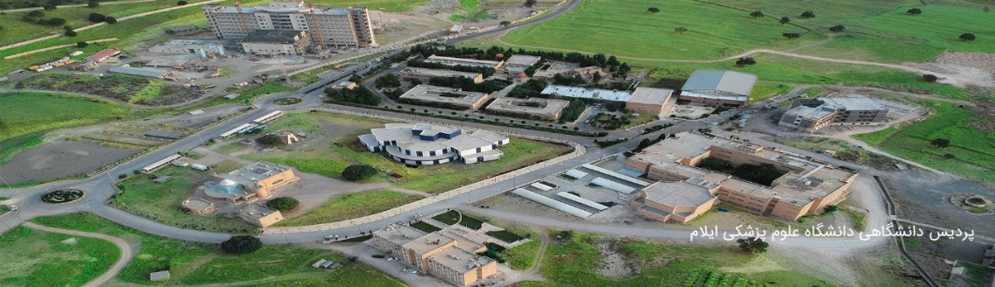
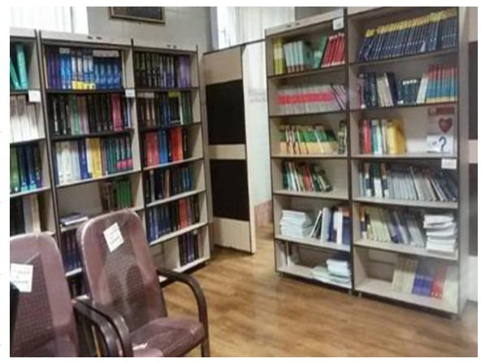
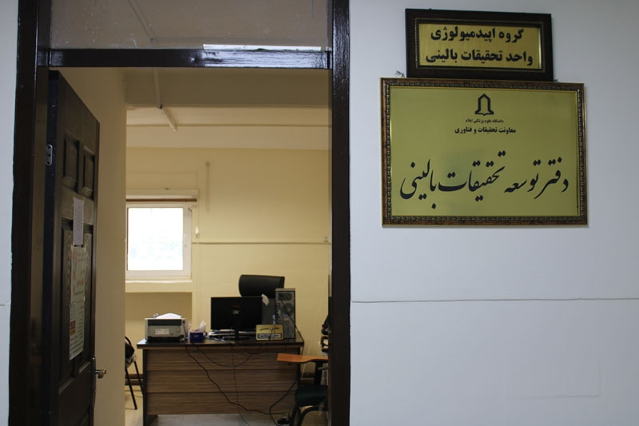


Slide 3
Clinical research development unit of emam Khomeini Hospital
This unit started its official work in 10 October 2019 and completed the project in July of the same year. The Research Development Unit provides policy and funding support for health and medical research, for both WA Health and the wider WA health and medical research sector. Research workshops and provision of movie conferences are among other activities of the unit.

Slide 4
Objective
Empower faculty and learners
Hold Empowerment Target Group of Clinical Development and Research Unit in Research Skills Using Training Programs
Advanced reference and workshop management workshops
Providing research advice
Holding paper workshops, writing submissions and submitting to journals
Hold a meeting of the Research Council of Development and Clinical Research Unit with the aim of reviewing and approving research projects

Slide 5
Overview
Our goals are to relax all the aspects of our being.
Since man is a multidimensional creature, he must embrace all of these existential dimensions in his own way and not merely be promoted in one way. What is emphasized in this area by counselors, psychologists and educators in this field. Man is an emotional being and he must also choose spiritual goals for his emotional development
.

Slide 6
in the name of God
List of ongoing and ongoing projects of Imam Khomeini Hospital Development and Research Unit
Mr. Ali Khani | Comparative study of the effects of gabapentin, celecoxib and their combination on pain and cystic complications after laminectomy in patients referred to Imam Khomeini educational hospitals in Ilam, 2014 | 1
Dr. Gholam Reza kalvandi | Frequency and risk factors and treatment of hepatitis B by systematic review and meta-analysis. | 2
Dr. Nowruzi | Effectiveness of atorvastatin on alpha and beta apolipoproteins by systematic review and meta-analysis | 3
Dr. Behzad Darabi | Evaluation of the role of lead and zinc in asthma by systematic review and meta-analysis. | 4
Dr. Nourollahi | Prevalence and severity of preterm infants born in Taleghani and Mostafa Khomeini Hospital of Ilam | 5
Dr. Behzad Darabi | Evaluation of spirometry in children aged 6-12 years in Ilam city schools | 6
Ms. Shoboo Rahmati | The Relationship Between Gastroesophageal Reflux and Periodontal Disease: A Systematic Review | 7
Dr. Mohammad Reza Hafezi | Changes in Myocaine Serum Level in Inactive Obese and Abdominal Obesity Women Comparison Between Exercise / Resistance with Linear and Nonlinear Scheduling | 8
Dr. Mohammad Reza Hafezi | Use of insulin and insulin analogues and cancer risk - a systematic review and meta-analysis | 9
Dr. Behzad Darabi | Evaluation of spirometry in children aged 6-12 years in Ilam city schools | 6

Slide 7
Dr. Parviz Karimi | Relationship between iron deficiency anemia and febrile seizure by systematic review and meta-analysis | 10
Dr. Massoud Hatefi | Comparative study of the effect of general anesthesia and spinal anesthesia on the outcome of laminectomy in patients referred to Imam Khomeini medical centers in Ilam in 2015 | 11
Dr. Aminullah Wassiq | Comparative study of the effect of sevoflurane and propofol on hemodynamic changes and complications after laminectomy in patients referred to Imam Khomeini Medical Center in 2015 | 12
Dr. Gholamreza kalvandi | Evaluation of head trauma and its associated costs in children 0-19 years old referred to Imam Khomeini and Mostafa Hospital | 13
Dr. Milad Azami | The Relationship between Metabolic Syndrome and Erosive Esophagitis: A Systematic Review and Meta-Analysis Study | 14
Ehsan Mohammadi | Nurses' Knowledge and Attitude toward Bed Wound Prevention at Ilam University of Medical Sciences in 1398 | 15
Dr. Reza Najafi | Evaluation of biochemical changes due to growth hormone treatment in Kurds and adolescents up to 16 years old in Ilam in the last 5 years | 16
Dr. Mohammad Karimian | Prevalence of dyspepsia in Iran: A systematic and meta-analysis study | 17
Dr. Mohammad Karimian | Relationship between Metabolic and Esophageal Syndrome with Rats: A Systematic and Meta-Analysis Study | 18
Dr. Hassan Nourmohammadi | Effect of alcoholic extract of Chamomile on growth inhibition and enhancing HER2 / neu Cell Lines cell proliferation in breast cancer. | 19

Slide 8
Dr. Hassan Nourmohammadi | The effect of ethanolic extract of women on growth inhibition and enhancement of K-RAS / Cell Line proliferation in colon cancer. | 20
Dr. Kafashian | Effect of silver nanoparticles isolated from chamomile on growth inhibition and enhancing HER2, Krass cell proliferation | 21
Dr. Moradi | Investigation of the relationship between laboratory criteria (CBC, CRP, UT) in children with focal non-fever, bacteremia and malignant infections (sepsis, meningitis, pyelonephritis). | 22

Slide 9
Register approved by emam Khomeini Hospital
Dr Masoumi | Kidney stone registry | 1

Slide 10
Published Articles Clinical Development and Research Unit of emam Khomeini Hospital

Slide 11
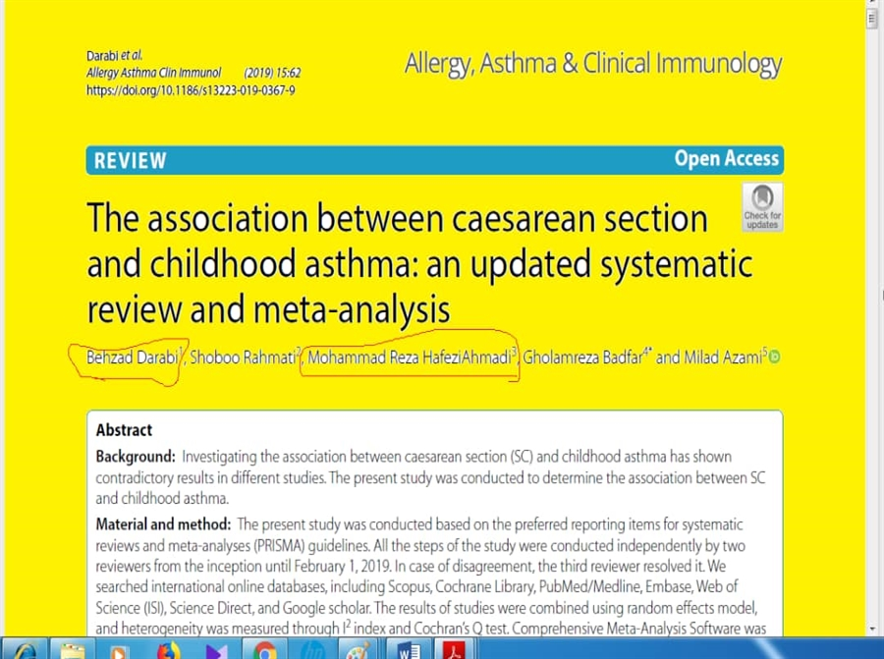
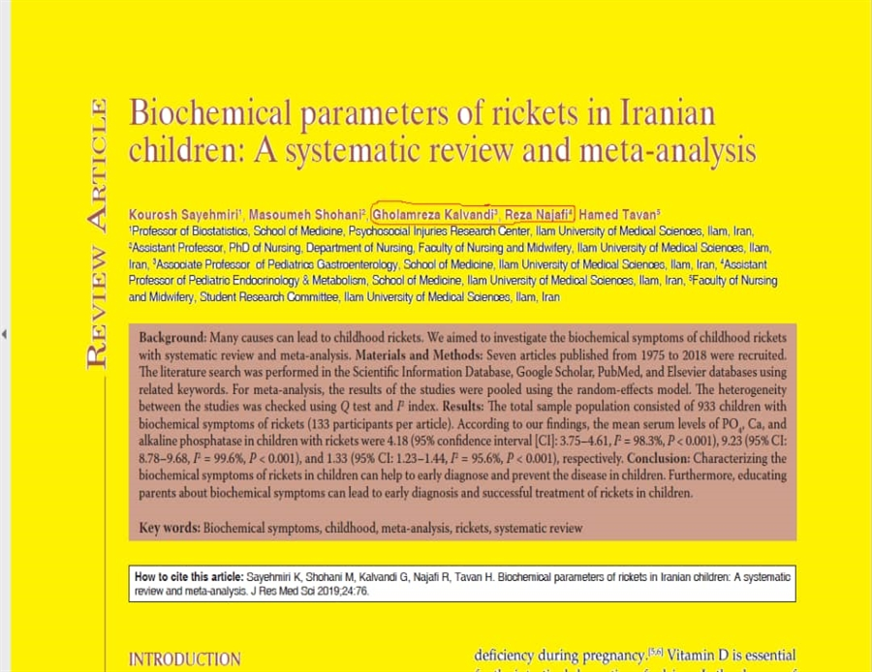

Slide 12
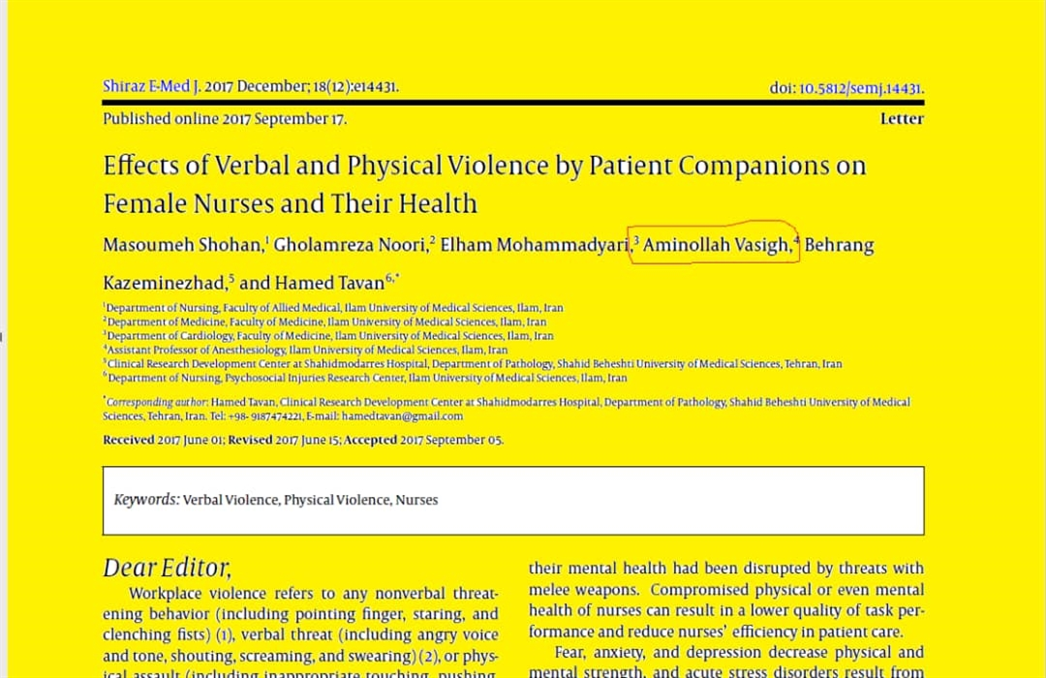
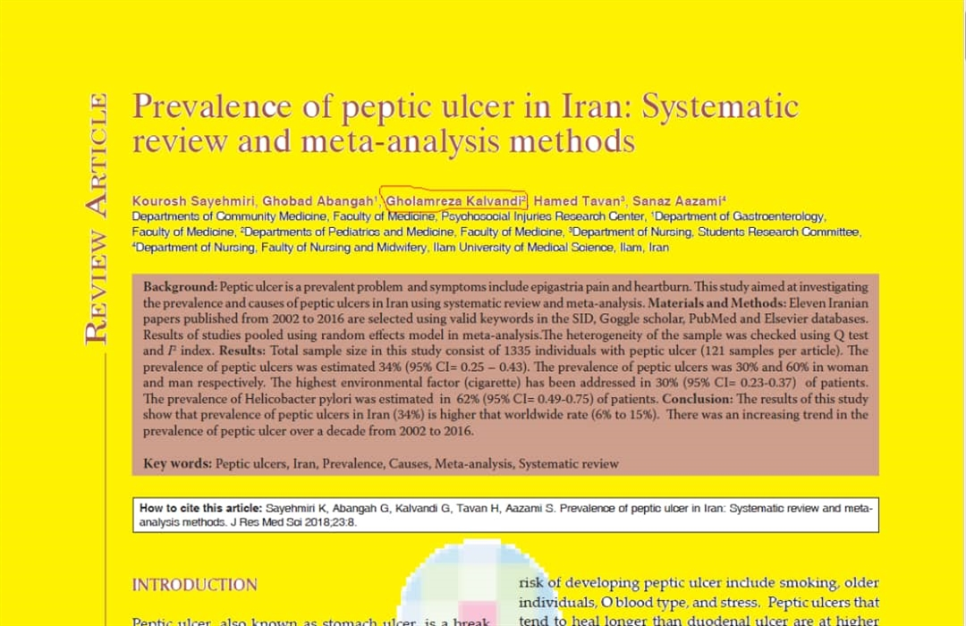

Slide 13


